Slide 1

ARDUINO PROJECT
Zeynep Gizem ÇETİNCİ YALÇIN

Slide 2
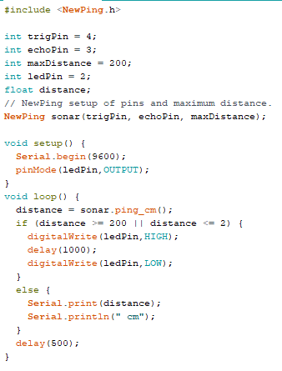
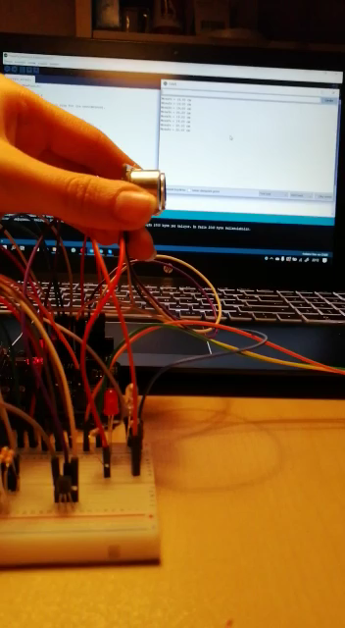
LIGHT BULB FOR OUTDOOR: ULTRASONIC SENSOR

Slide 3
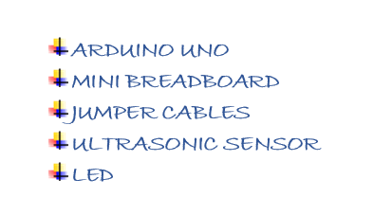
LIGHT BULB FOR OUTDOOR: ULTRASONIC SENSOR

Slide 4
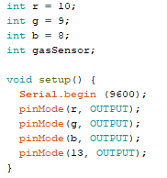
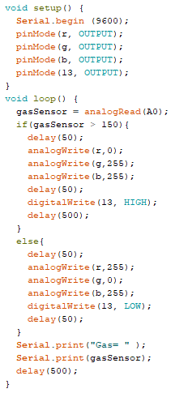
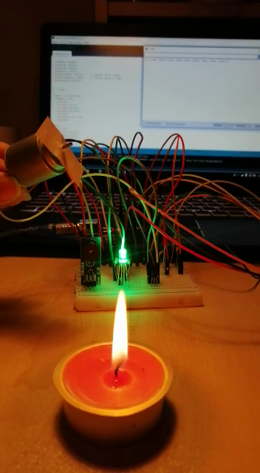
LIGHT BULB FOR OUTDOOR: GAS SENSOR

Slide 5
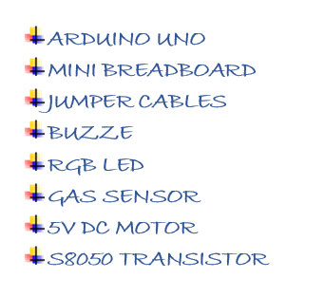
LIGHT BULB FOR OUTDOOR: GAS SENSOR

Slide 6
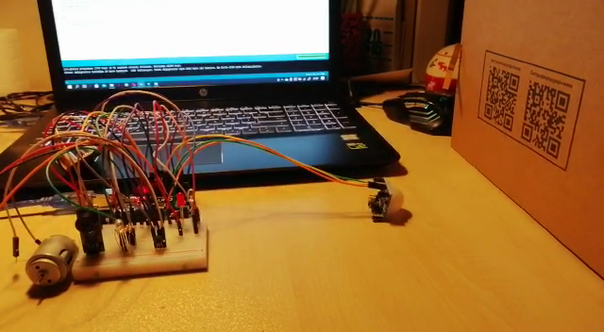
LIGHT BULB FOR OUTDOOR: PIR MOTION SENSOR

Slide 7
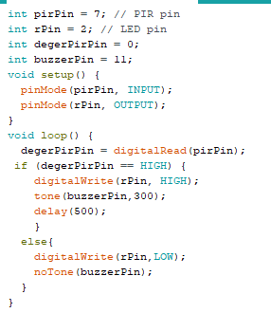
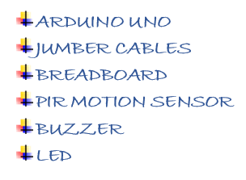
LIGHT BULB FOR OUTDOOR: PIR MOTION SENSOR

